Slide 1
Health system
Housing affordability
Unemployment
National security and terrorism
Tax avoidance by big companies
Budget deficit
Dec
2014
June
2015
Dec
2015
June
2016
Dec
2016
June
2017
Notes:
Public concern about housing affordability is on the rise
What are the three most important issues for Government? 2014 to 2017
Sources:
AHURI: https://www.ahuri.edu.au/evidence-in-action/news/how-concerned-are-australians-about-housing
Essential Report: What are the three most important issues for Government? 2014 to 2017
Location
C:\Users\wiltshire\Dropbox (Grattan Institute)\Budget Repair Report\Data and analysis\Housing and mortgage affordability\Public opinion about housing affordability\Essential - most important issues for governments.xlsx

Slide 2
Survey of income and housing
National accounts
Household expenditure survey
Notes:
Title:
Across all measures, spending on housing as a share of income has increased
Units:
Housing costs as a share of gross household income, per cent
Notes: National accounts: Rent paid by households to the owners of dwellings, plus imputed value of housing services accruing to owner-occupiers (both their principal residence and any additional residence) and water and sewerage services, as share of gross disposable income (aggregate measure, nominal)
Survey of Income and Housing: Mean household rent, mortgage and rates (general and water) payments as share of mean gross household income
Household Expenditure Survey: Mean household rent, mortgage (principal plus interest) and rates payments as share of mean gross household income
Sources: ABS
Location: C:\Users\wiltshire\Dropbox (Grattan Institute)\Budget Repair Report\Data and analysis\Housing and mortgage affordability\Spending on housing .xlsx

Slide 3
Income quintile
Lowest
Second
Third
Fourth
Highest
Financial year ending
Notes:
Title:
Spending on housing has grown the most for lower-income households over time
Units:
Housing costs as a proportion of gross household income, by equivalised disposable
household income quintile
Notes: housing costs include rent, mortgage and rates (general and water) payments as share of gross household income for each quintile. Data interpolated for missing years
Source: ABS 4130.0 Housing Occupancy and Costs
Location: C:\Users\wiltshire\Dropbox (Grattan Institute)\Budget Repair Report\Data and analysis\Housing and mortgage affordability\4130 - Housing occupancy and costs\Housing occupancy and costs - analysis.xlsx

Slide 4
Dwelling prices
Average full-time earnings
1970
1975
1980
1985
1990
1995
2000
2005
2010
2015
Notes:
Chart title: Younger cohorts have missed out on the windfall of buying a house before 1997
Y-axis label: Index 1970=100
Source(s):Yates (2011b) Housing in Australia in the 2000s: On the Agenda Too Late? The Australian Economy in the 2000s, cited in Renovating housing p12; ABS
C:\Users\wiltshire\Dropbox (Grattan Institute)\Budget Repair Report\Data and analysis\Housing and mortgage affordability\2017 Housing affordability op ed\Housing and mortgage costs-affordability simulations.xlsx
Tab ‘Dwelling prices’, cols A-D
Yates data from: C:\Users\wiltshire\Dropbox (Grattan Institute)\wealth of generations report\Data Analysis\Housing\Yates 2000 RBA from Cam Harrison.xlsx

Slide 5

2001
2016
Sydney
Regional NSW
Melbourne
Regional Vic
Brisbane
Regional Qld
Adelaide
Regional SA
Perth
Regional WA
Notes:
TITLE: House price to income ratios have jumped in cities AND regions
Units: Ratio of median dwelling price to median annual gross household income
Notes: median household income from ANU analysis
Source: Core Logic Housing Affordability Report – December 2016

Slide 6
2014
2006
Notes:
Title: Inner ring house prices grew faster than outer ring prices
Units: Ratio of inner ring to outer ring median prices, detached houses only, four-quarter average
Source: http://www.rba.gov.au/speeches/2015/sp-so-2015-09-08.html; REIA

Slide 7
Residential improvements
(3% Compound Annual Growth Rate)
Residential land (6% CAGR)
Notes:
Title: Some increase in prices reflects more and better dwellings, most reflects land values
Units: Real market value of Australian property, $2016, trillions
Notes: ‘Residential improvements’ consists of the value of the stock of dwelling construction; historical figures are deflated by the Consumer Price Index to $2016.
Source: ABS 5204.0; ABS 6401.0; Grattan analysis.

Slide 8
All dwellings
Houses
Apartments, units, townhouses etc.
Dwelling price decile
Notes:
Title: Cheaper dwellings have increased in price by more than expensive dwellings over the past decade
Units: Per cent change in dwelling prices between 2003-04 and 2015-16, by dwelling price decile in each year
Notes: average dwelling price in each decile. ‘Semi-detached/townhouses’ includes semi-detached house, row or terrace house and townhouse.
Source: ABS Survey of Income and Housing
C:\Users\wiltshire\Dropbox (Grattan Institute)\Budget Repair Report\Data and analysis\Housing and mortgage affordability\2017 Housing affordability op ed\Rents and house price distribution analysis - SIH.xlsx

Slide 9
If interest rates increase by 2ppt by
2019-20
0
Notes:
Title: Income required to service a mortgage is below pre-GFC peak, but will increase if interest rates rise
Units: Per cent of household income to service an 80 per cent loan-to-valuation ratio mortgage on average residential dwelling at then current interest rates
Notes: Mean income is household disposable income from National Accounts measure of income (based on ABS), which includes superannuation income and imputed rent. Median household income is gross household income from ABS 6523.0 - Household Income and Wealth, Australia, 2013-14. Future scenario assumes house prices and incomes grow at 3 per cent per annum.
Source: Grattan analysis of ABS
Location: <C:\Users\wiltshire\Dropbox (Grattan Institute)\Budget Repair Report\Data and analysis\Housing and mortgage affordability\2017 Housing affordability op ed\Housing and mortgage costs-affordability simulations.xlsx> tab “Mortgage serviceability”

Slide 10
If interest rates increase by 2ppt by
2019-20
Notes:
Chart title: The costs of servicing a mortgage are far higher now than in the early 1990s
Y-axis label: Mortgage interest payments as a share of disposable income, per cent
Note(s):
Source(s): RBA Statistical Tables, E2: Household finances – selected ratios.
File Path: ='C:\Users\wiltshire\Dropbox (Grattan Institute)\Budget Repair Report\Data and analysis\Housing and mortgage affordability\[RBA Household Finances – Selected Ratios – E2-data.csv]RBA Household Finances – Select'!K18

Slide 11
Buying in 2017
Buying in 1990
Buying in 2003
Years after dwelling purchase
Notes:
Title: A home is harder to pay off given larger loans and low wages growth
Units: Mortgage repayments on an average house (20 per cent deposit), per cent of median household income, 25 year principal and interest loan
Notes: 2017 average dwelling price is $669,700; 2003 house price is $319,802 1990 house price is $141,517. Mortgage repayments on an average house (20 per cent deposit), 25 year principal and interest loan. Average wages and interest rates over life of loan. Current wage growth and interest rates projected forwards. .
Source: ABS; RBA; Grattan analysis; CoreLogic Australia (2016).

Slide 12
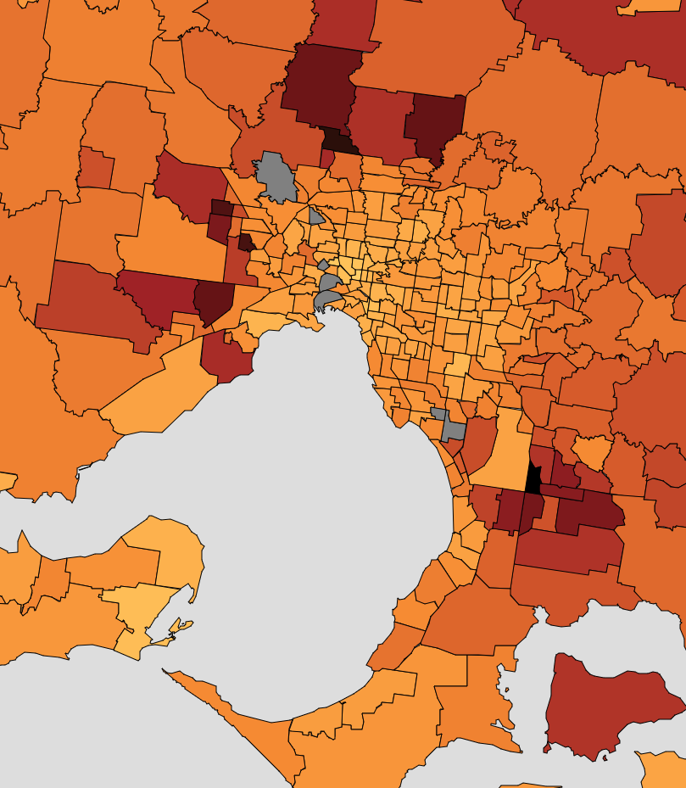
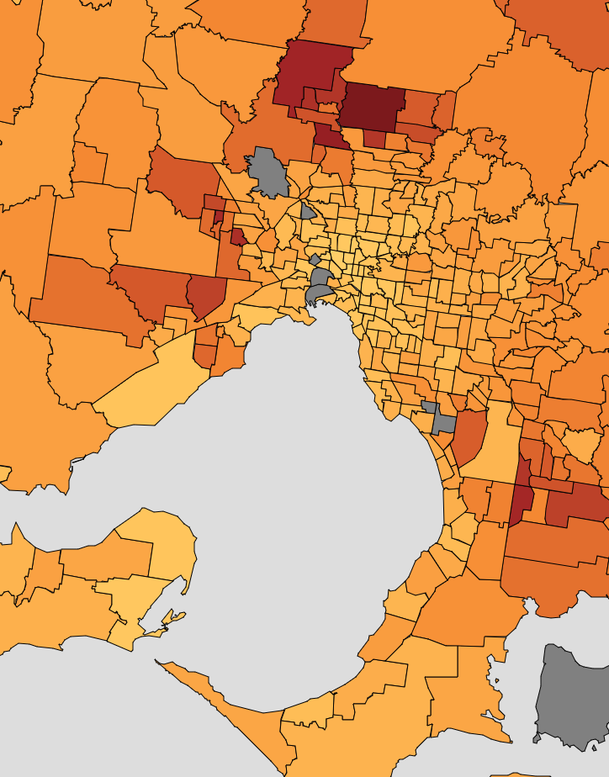
2011
2016
5
10
% of h’holds under
mortgage stress
15
20
25
30

Slide 13
Housing
prices
Rents
Wages
CPI
Notes:
Rents have not diverged from wages, but are a long way from house prices
Nominal, index, 1997 = 100
Notes: Nominal house price growth; All Groups CPI; Wage price index (excluding bonuses; private and public)
Source: ABS 6401.0 Consumer Price Index, Australia; OECD Affordable Housing Database
C:\Users\wiltshire\Dropbox (Grattan Institute)\Budget Repair Report\Data and analysis\Housing and mortgage affordability\2017 Housing affordability op ed\Housing op ed analysis.xlsx
Tab “Rents v prices growth”

Slide 14
Home owner
Renter
Notes:
Title: Renting pensioners are under more stress than home-owning retirees – but less than others
Units: Percentage of households facing at least one financial stress, 2015-2016
Notes: Financial stress defined as money shortage leading to 1) skipped meals; 2) not heating home; 3) failing to pay gas, electricity or telephone bills on time; or 4) failing to pay registration insurance on time. ‘Pension’ includes everyone over the age of 65 who receives social assistance benefits in cash of more than $100 per week . ‘Welfare’ includes those who receive more than $100 per week from a disability support pension, carer payment, unemployment or student allowances, other government pension and allowances..
Sources: ABS Household Expenditure Survey 2015-16, Grattan analysis.

Slide 15
2007-08
2009-10
2011-12
2013-14
2015-16
Notes:
Title: Rental stress among low-income households is increasing in capital cities
Units: Per cent of low-income renters with housing costs more than 30 per cent of gross household income
Notes: Low income households are defined as the 40 per cent of households with equivalised disposable household income (excluding Commonwealth Rent Assistance) at or below the 40th percentile.
Source: ABS 4130.0 - Housing Occupancy and Costs
C:\Users\wiltshire\Dropbox (Grattan Institute)\Budget Repair Report\Data and analysis\Housing and mortgage affordability\4130 - Housing occupancy and costs\Housing occupancy and costs - analysis.xlsx

Slide 16
All dwellings
Houses
Apartments, units, townhouses etc.
Private rental decile
Notes:
Title: Rents for cheaper dwellings have increased the most over the past decade
Units: Per cent change in rents between 2003-04 and 2013-14, by rent decile in each year
Notes: average rent in each decile. ‘Semi-detached/townhouses’ includes semi-detached house, row or terrace house and townhouse.
Source: ABS Survey of Income and Housing
C:\Users\wiltshire\Dropbox (Grattan Institute)\Budget Repair Report\Data and analysis\Housing and mortgage affordability\2017 Housing affordability op ed\Rents and house price distribution analysis - SIH.xlsx

Slide 17
2001-06
2006-11
Inner
Middle
Outer
Inner
Inner
Middle
Middle
Outer
Sydney
Melbourne
Notes:
Title: Most jobs growth was in city centres over the last decade
Units: Employment growth, Sydney and Melbourne, thousands
Source: : Grattan analysis; BITRE

Slide 18
Annual resident population growth, 000s
Total population growth,
2006 to 2016, millions
All other
Perth
Brisbane
Ad/Canb/ Darwin/ Hobart
Net overseas migration
Melbourne
Natural increase
Sydney
Notes:
Title: Migration growth was much higher 2006-2016, and so capital city populations jumped
Units: Annual resident population growth, per cent
LH panel: Source: ABS 3101.0 - Australian Demographic Statistics, Jun 2016 ; Department of Immigration and Border Protection forecasts https://www.border.gov.au/ReportsandPublications/Documents/statistics/nom-september-2016.pdf
C:\Users\wiltshire\Dropbox (Grattan Institute)\Budget Repair Report\Data and analysis\Housing and mortgage affordability\2017 Housing affordability op ed\Housing op ed analysis.xlsx
RH panel: ABS 3218.0 Regional Population Growth, Australia
C:\Users\wiltshire\Dropbox (Grattan Institute)\Budget Repair Report\Data and analysis\Housing and mortgage affordability\2017 Housing affordability op ed\Population by signficnat urban area.xls
Notes: Notes: series break in 2006 when ‘net overseas migration’ definition was changed

Slide 19
NSW
Victoria
Qld
WA
SA
Tas, NT,
ACT
Notes:
Overseas migration into NSW and Victoria is almost at the record levels seen prior to the GFC
4 quarter rolling annual sum, thousands of people
Notes: series break in 2006 when ‘net overseas migration’ definition was changed
Source: ABS 3101.0 - Australian Demographic Statistics,

Slide 20
0-9
Gen Z
Last BB
age today/ Gen X
50-59
Gen X
40-49
20-29
Gen Y
10-19
Gen Y
30-39
Gen X/ Gen Y
60-69
Baby boomers
Notes:
Australia’s population was significantly reshaped by the late 2000 migration wave
Australian population by age, millions
Sources: 3105.0.65.001 Australian Historical Population Statistics, 2014 , Census 2016; Grattan analysis
From: C:\Users\wiltshire\Dropbox (Grattan Institute)\Housing affordability\Data and analysis\All housing affordability charts - June 15.pptx
QC: C:\Users\wiltshire\Dropbox (Grattan Institute)\Budget Repair Report\Data and analysis\Housing and mortgage affordability\Housing affordability QC\Population by Generation and Time.xlsx

Slide 21
Special and humanitarian
Net overseas
migration
Permanent
Skilled
Family
Visitor and other
Working holiday
Temporary
Skilled (457)
Students
Net Aus, NZ and other citizens
Notes:
Figure 13: Australia’s net migrant intake is expected to rise to 250,000 by 2020, sourced mostly from existing temporary residents
Net overseas migration, by visa type
Source: ABS 3412.0 - Migration, Australia, 2015-16 (ABS (2017).
C:\Users\wiltshire\Dropbox (Grattan Institute)\Budget Repair Report\Data and analysis\Housing and mortgage affordability\3412 Net overseas migration by visa category -do008_201516.xls

Slide 22
Housing features
Location
Financial considerations
Notes:
Title: A downsized home is chosen primarily for features and location, not financial outcomes
Sub title: Important consideration when moving, percentage of downsizers
Judd 23014
https://grattan.edu.au/wp-content/uploads/2017/06/COTA-seniors-housing-2017-June-16-9-original.pdf

Slide 23
Population increase per year, thousands
Dwellings completed per year, thousands
Other
SA
2005 to 2016
average
WA
Qld
Vic
NSW
1990 to 2004
average
Notes:
Title: Housing construction lagged population growth for much of the 2000s, but picked up recently
Units: On chart
Source: ABS 8752.0 Building Activity, Australia; ABS 3101.0 Australian Demographic Statistics; Grattan analysis
Location: C:\Users\wiltshire\Dropbox (Grattan Institute)\Budget Repair Report\Data and analysis\Housing and mortgage affordability\87310020 - Dwelling approvals - Australia - types of dwellings.xlsx
ABS source: http://www.abs.gov.au/AUSSTATS/abs@.nsf/DetailsPage/8731.0Jan%202017?OpenDocument

Slide 24
Queensland
NSW
Victoria
Australia
Notes:
Housing construction lagged population growth for much of the 2000s, but picked up recently
Completions per additional thousand people
Notes: does not take into account demolitions. Victorian series spikes at 3.5 in 1993 (cut off to improve readability).
Source: ABS 8752.0 Building Activity, Australia; ABS 3101.0 Australian Demographic Statistics; Grattan analysis
C:\Users\wiltshire\Dropbox (Grattan Institute)\Budget Repair Report\Data and analysis\Housing and mortgage affordability\87520038 - ABS building completions data.xlsx
ABS source: http://www.abs.gov.au/AUSSTATS/abs@.nsf/DetailsPage/8731.0Jan%202017?OpenDocument

Slide 25
Actual
ABS 2015
ABS 1999
ABS 2004
McDonald and
Temple 2013
Notes:
Most predictions were that the average household size would continue to fall, but it has remained unchanged since 2000
Average household size, actual and projected
Notes: ABS projections are series II/B projections. ABS 1999 projection for 2021 is for average household size to be between 2.2 and 2.3
Source: ABS; McDonald and Temple (2013)

Slide 26
Portugal
Bulgaria
2000
France
2015
Finland
Switzerland
Austria
Germany
Cyprus
Sweden
Denmark
Netherlands
Hungary
Norway
Lithuania
Ireland
UK
USA
Luxembourg
Australia
New Zealand
Poland
Chile
Notes:
For its population, Australia has relatively little housing stock, and it’s falling
Dwelling stock per 1,000 people
Notes:
Source: OECD Affordable Housing Database

Slide 27
Average annual building approvals, 1992-2017
Middle and high rise apartments
Low-rise apartments
Semi-detached, townhouses,
terraces
Houses
Notes:
Title: High-rise apartments account for most of the increase in dwelling approvals
Units: Annual building approvals by dwelling type, thousands
Notes: ‘Low-rise apartments’ are flats, units and apartments in one, two or three storey blocks. ‘High-rise apartments’ are flats, units and apartments in four or more storey blocks.
Source: ABS 8731.0 - Building Approvals, Australia
Location: C:\Users\wiltshire\Dropbox (Grattan Institute)\Budget Repair Report\Data and analysis\Housing and mortgage affordability\Copy of Graph 7 - Economic Performance of the States - RBA Bulletin.xlsx
ABS source: ABS 8731.0 - Building Approvals, Australia, Jan 2017; RBA bulleting

Slide 28
Sydney
Melbourne
Brisbane
No. of
storeys
2-3
4-9
10-19
20-39
40+
City region
Notes:
Many mid-rise apartments are being built in the middle ring suburbs of Sydney
Apartment completions, 2014-17 completions/projected completions
Note: Includes the number projects containing 10 or more dwellings. Some projects are under construction but are expected to be completed in 2017. The Central city region = CBD and approximately 0-2 km from the CBD. City fringe region = approximately 2-5 km from the CBD. Inner region =approximately 5-10 km from each CBD. Middle region = approximately 10-35 km from each CBD. Outer region = approximately 35 km+ from the CBD. Middle Brisbane is work in progress, outer Brisbane is not tracked
Source: Charter Keck Cramer
Location:

Slide 29
Sydney
Melbourne
Brisbane
City region
Outer
Middle
Inner
City fringe
Central city
Notes:
Apartment construction in Melbourne and Sydney took off from 2013
Apartment completions and projected completions, thousands
Notes: The Central city region = CBD and approximately 0-2 km from the CBD. City fringe region = approximately 2-5km from the CBD. Inner region = approximately 5-10km from each CBD. Middle region = approximately 10-35km from each CBD. Middle region = approximately 10-35km from each CBD. Outer region = approximately 35km+ from the CBD. Middle Brisbane is work in progress, Outer Brisbane is not tracked.
Source: Charter Keck Cramer

Slide 30
Sydney
Melbourne
Brisbane
No. of
storeys
2-3
4-9
10-19
20-39
40+
Notes:
Apartment construction in Melbourne and Sydney took off from 2013
Apartment completions and projected completions, thousands
Notes: The Central city region = CBD and approximately 0-2 km from the CBD. City fringe region = approximately 2-5km from the CBD. Inner region = approximately 5-10km from each CBD. Middle region = approximately 10-35km from each CBD. Middle region = approximately 10-35km from each CBD. Outer region = approximately 35km+ from the CBD. Middle Brisbane is work in progress, Outer Brisbane is not tracked.
Source: Charter Keck Cramer

Slide 31
Sydney
Melbourne
0
5
10
15
20
25
30
35
40+
Distance to CBD (km)
Notes:
C:\Users\wiltshire\Dropbox (Grattan Institute)\Budget Repair Report\Data and analysis\Housing and mortgage affordability\3218 - population by SA2 - regional pop growth - updated.xls
The last decade has seen some urban infill in Melbourne and particularly in Sydney
Population increase between 2006 and 2016, by distance from CBD
Notes: Distance from middle of Statistical Area Level 2 (SA2) to capital city GPO
Source: ABS 3218.0 - Regional Population Growth, Australia; Grattan analysis

Slide 32
2006 to 2011
2011 to 2016
2017
Required to meet housing target
Notes:
C:\Users\wiltshire\Dropbox (Grattan Institute)\Budget Repair Report\Data and analysis\Housing and mortgage affordability\Matching housing targets and council supply\State govt planning targets and council supply.xlsx
Housing construction will need to keep increasing to meet city plan housing targets
Average annual net housing construction
Notes: Towards Our Greater Sydney 2056: 725,000 additional dwellings over 2016-2036 (excludes the Central Coast). Plan Melbourne 2017: 1,550,000 additional dwellings over 2015–2051 (based on Victoria in Future projections). For 2006 to 2016 data, growth in dwelling stock is calculated using 2016 Greater Capital City Statistical regions. Data for 2017 dwelling completions in Sydney assumes a 10 per cent demolition rate
Sources: Greater Sydney Commission (2016); Victorian Government (2017); NSW Department of Planning and Environment (2018).
Source: ABS Census; Towards Our Greater Sydney 2056; Plan Melbourne 2017; Grattan analysis

Slide 33
1981
2016
Sydney
Melbourne
Brisbane
Adelaide
Perth
0-5
5-10
10-15
15-20
20-25
25-30
Distance to GPO, km
Notes:
Population density has increased overall, but not much in the middle ring
Population density (per square kilometer), 1981 and 2011
Source: Coffee et al, “Visualising 30 Years of Population Density Change”
Notes: Coffee et al updated to 2016 using 2016 Census data. Population density for Adelaide in 2016 is only shown to 20kkm from GPO as definition of Adelaide in 2016 is different to the definition used in 1981 and 2011
Source: Coffee et al 2016 “Visualising 30 Years of Population Density Change”

Slide 34
Median lot price $000s
Land price $ per square metre
Lots released 000s
Sydney
SE Qld
Melbourne
Notes:
Source: UDIA 2017 state of land report; Charter Keck Cramer; Research 4
Location: C:\Users\Trent\Dropbox (Grattan Institute)\Budget Repair Report\Data and analysis\Housing and mortgage affordability\2017 Housing affordability op ed\Greenfield land prices and size - UDIA.xlsx
Notes: Nominal dollars
Source: UDIA 2013 and UDIA 2017 State of Land Report
Greenfield land prices have increased in recent years, and lot sizes have become smaller

Slide 35
Gov’t taxes
and charges
Land
Developer profit
Development cost & interest
Professional fees
Construction
Sydney
Melbourne
Brisbane
Perth
Adelaide
Notes:
Title: Greenfield development is expensive in Sydney due to higher land prices and government charges
Units: Greenfield dwelling price in capital cities, $2010
Source: Source: Urbis 2011 (National dwelling cost study, prepared for National Housing Supply Council 2011)
https://www.treasury.gov.au/~/media/Treasury/Publications%20and%20Media/Publications/2011/National%20Dwelling%20Costs%20Study/Documents/PDF/nhsc-residential-cost-analysis-urbis.ashx

Slide 36
Series break
Community housing
Public housing
Notes:
Australia’s public housing stock has not kept pace with population growth
Social housing share of total housing stock, per cent
Series break from 2000
Source: Productivity Commission Report , Housing Assistance and Employment in Australia, Volume 2 – Research Papers, April 2015, p. 3; Eslake AIST - http://www.aist.asn.au/media/20734/AIST_Housing%20affordability%20and%20retirement%20incomes_FINAL%2021032017.pdf

Slide 37
Growth in income
Growth in income less housing costs
Equivalised household disposable income quintile
Notes:
Gains to real income have been mitigated by increasing housing expenditure
Increase in real equivalised disposable income, 2003-04 to 2015-16, per cent
Notes: Income quintiles are calculated using household disposable income, equivalised by family size. Housing costs are those according to the ABS survey of income and housing and include rents for renters and repayments on loans for owners with mortgages
Source: SIH 2003-04 and SIH 2015-16

Slide 38
65+
55-64
45-54
35-44
25-34
Notes:
Title: 2016 Census confirms that home ownership rates continue to fall among all but the oldest Australians
Units:Home ownership rate by age, per cent
Notes: Per cent of occupied private dwellings. Household age group according to age of household reference person. Excludes households with tenure type not stated.
Source: ABS Census; Yates 2015; Colebatch 2017
C:\Users\wiltshire\Dropbox (Grattan Institute)\Budget Repair Report\Data and analysis\Housing and mortgage affordability\Census 2011 and 2016\Home ownership rate - census analysis.xlsx
Yates Senate Submission 2015 - http://www.aph.gov.au/DocumentStore.ashx?id=09aeea3d-4921-4e78-8df1-ee83fb39801b&subId=352865
Colebatch - http://insidestory.org.au/one-census-three-stories

Slide 39

Age group
25-34
35-44
45-54
55-64
1981
2016
Equivalised household income quintile
Notes:
Title: Home ownership is falling for younger age groups, and particularly among low income earners
Units: Home ownership rates by age and income, 1981 and 2016
Notes: This graph updates Burke et al 2014 using Census data obtained from the ABS. Difficulties in accurately calculating household incomes across time using Census data means that changes in home ownership rates by age and income are indicative and small changes in ownership rates should be ignored. Excludes households with tenancy not stated (for 2016) and incomes not stated. Household age group according to age of household reference person. Income quintiles are equivalised household income quintiles.
Source: ABS Census; Burke et al 2014 ‘Generational change in home purchase opportunity in Australia’; Grattan Institute
NB: change arrow size to roughly the required size and then copy and paste in each point
C:\Users\wiltshire\Dropbox (Grattan Institute)\Budget Repair Report\Data and analysis\Housing and mortgage affordability\Census 2011 and 2016\Home ownership - by age and income - Census 2016.xlsx

Slide 40
Other
Private renter
Social / public renter
Notes:
Future retirees are more likely to be living in private rental housing
Renters as per cent of population
Yates 2016

Slide 41
65+
55-64
45-54
35-44
25-34
Survey year – financial year ending
Notes:
Title: Fewer Australians own their homes outright than in the past
Units: Per cent of households that own home outright, by age group
Notes: by age of household reference person
Source: 4130.0 - Housing Occupancy and Costs, 2013-14 + income and wealth
C:\Users\wiltshire\Dropbox (Grattan Institute)\Budget Repair Report\Data and analysis\Housing and mortgage affordability\4130 - Housing occupancy and costs\41300do001_201314 - Table 1.xls – TABLE 3

Slide 42
Length of time in current dwelling per cent of tenure type
Satisfaction with housing per cent of tenure type
10+ years
Very
satisfied
3-9 years
1-2 years
Satisfied
Less than
1 year
Neutral
Dissatisfied/
v. dissatisfied
Owner no mortgage
Owner with mortgage
Renter public
Renter private
Owner no mortgage
Owner with mortgage
Renter public
Renter private
Notes:
C:\Users\wiltshire\Dropbox (Grattan Institute)\Budget Repair Report\Data and analysis\Housing and mortgage affordability\4130 - Housing occupancy and costs\Housing occupancy and costs - analysis.xlsx
Source: 4130.0 - Housing Occupancy and Costs, 2013-14

Slide 43
Number of properties owned (ex primary residence)
Notes:
Title: Most investment properties are owned by small landlords
Sub-title: Share of total investment properties by number of properties owned by investor, 2014-15
Note: An interest in a property means the property is either solely owned, or jointly owned for all or part of the year. Excludes those that own no residential property other than their primary residence.
Source: Grattan analysis of ATO Taxation Statistics, 2014-15

Slide 44
Sydney
Melbourne
Brisbane
Land tax
Post-tax income return
Size of investor
Notes:
Progressive land taxes discourage large investors from holding residential property
Small – 1 home
Medium – 5 homes
Large – 25 homes
Land tax paid and post-tax income return, % of asset value
Sydney
Notes: Based on $880,000 median-priced Sydney dwelling and a 4 per cent gross rental return. The land value is assumed to be half the value of the property. Applies 2017 NSW land tax regime. Ignores deductibility of land tax costs against income in personal and corporate income tax returns.
Source: NSW Office of State Revenue; Corelogic; Grattan analysis.
Melbourne
Notes: Based on $720,000 median-priced Melbourne dwelling and a 4 per cent gross rental return. The land value is assumed to be half the value of the property. Applies 2017 NSW land tax regime. Ignores deductibility of land tax costs against income in personal and corporate income tax returns.
Source: Victorian State Revenue Office; Corelogic; Grattan analysis.
Brisbane
Notes: Based on $490,000 median-priced Brisbane dwelling and a 4 per cent gross rental return. The land value is assumed to be half the value of the property. Applies 2017-18 land tax regime. “Large investor” is subject to land tax regime for resident individuals, “Company” subject to corporate land tax regime. Ignores deductibility of land tax costs against income in personal and corporate income tax returns.
Source: Queensland State Revenue Office Land Tax Calculator; Corelogic; Grattan analysis.
Analysis here: C:\Users\wiltshire\Dropbox (Grattan Institute)\Housing affordability\Presentations and Media\Presentations\ISPT - Progressive state land taxes - 19 December 2017.pptx

Slide 45
2003-04
2005-06
2009-10
2011-12
2013-14
2015-16
$600,000 wealth increase
Age of head of household
Notes:
Mean wealth by age of head of household, $2015-16, thousands
Young households are not more wealthy than their predecessors; older age-groups are
Source: ABS Survey of Income and Housing, various years
Location - C:\Users\wiltshire\Dropbox (Grattan Institute)\Wealth of Generations Report\Presentations and media\Updated WoG charts - SIH and HES 15-16.pptx

Slide 46
Queensland
Australia
Victoria
NSW

Slide 47
Notes:
More first home buyers are receiving assistance from family and friends
Share of all first home buyers receiving loan from family or friends
Source: RBA; HILDA release 15.0
http://www.rba.gov.au/speeches/2017/sp-ag-2017-02-16.html

Slide 48
Equivalised disposable income
Equivalised net wealth
Lowest
Highest
Lowest
Highest
Income quintiles
Wealth quintiles
Notes:
Incomes have risen across the board; but wealth has concentrated
Real growth from 2003-04 to 2015-16 per equivalised household
Notes: Income estimates for 2003–04 onwards are not perfectly comparable with estimates for 2015-16 due to improvements in measuring income introduced in the 2007–08 cycle.
Source: ABS 6523.0 Household Income and Wealth, Australia

Slide 49
Highest
4th
3rd
2nd
Lowest
Notes:
Title: Debt has increased the most among high-income households
Units: Household debt to income ratio (for households with debt), by income quintile
(median), per cent
Source: RBA; HILDA Release 15.0
Data thief from RBA speech 2017, http://www.rba.gov.au/speeches/2017/sp-gov-2017-05-04.html
Source: HILDA

Slide 50
Strongly support
Support
First home owner
grants
More public housing
More homes built in local area
Remove tax incentives such as negative gearing
Relax planning restrictions
Notes:
Policy suggestions from:
http://politicsir.cass.anu.edu.au/sites/politicsir.anu.edu.au/files/ANUpoll-24-Housing-2017.pdf

Slide 51
Sydney
Melbourne
All capital cities
Notes:
Traffic and public transport congestion are the main reasons people don’t like population growth in their community
Per cent of respondents
(can sum to more than 100 as people could choose multiple options)
From Pc report - https://www.pc.gov.au/inquiries/completed/regulation-benchmarking-planning/report/planning-volume1.pdf , table 2.4

Slide 52
3+ bedrooms spare
2+ bedrooms spare
1+ bedrooms spare
No extra needed
1+ more needed
Housing tenure
Notes:
Title: Owner occupiers are much more like to have multiple spare bedrooms than renters
Sub-title: Households needing extra bedrooms or with spare bedrooms, 2015-16, per cent
Source: ABS (2015); Jericho (2017)

Slide 53
1995
2015
Notes:
Title: Effective rates of stamp duty have risen sharply in all states in the past two decades
Sub-title: Stamp duty payable on median-priced house in each capital city, per cent
Notes: Median prices are for a detached house. Darwin median price is for 2000. Assumes residential property and that the purchaser is not eligible for a concessional rate of stamp duty.
Source: Property Council; Core logic; Grattan analysis.

Slide 54
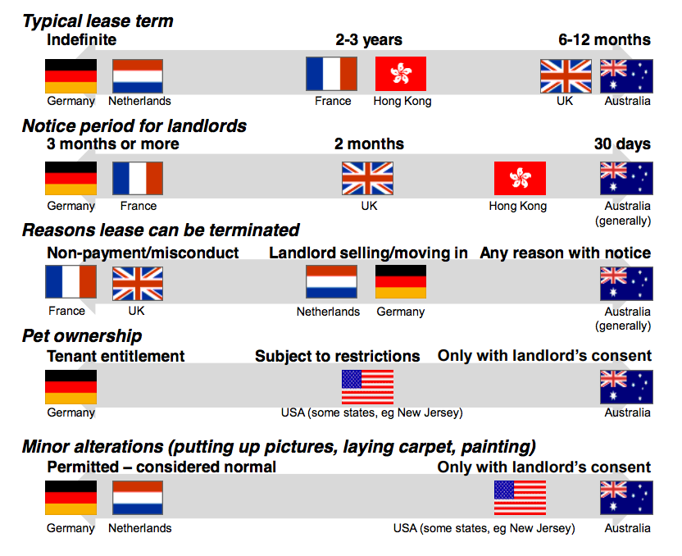
Notes:
Figure 5: Typical rental conditions in selected countries
Source: Kelly, Hunter, Harrison et al. (2013), Figure 3.1.

Slide 55
First home buyer packages
First home buyer grant doubled
First home buyer policy changes
NSW and Vic stamp duty concessions
NSW, Vic, Qld, NT
WA
SA, Tas, ACT
Notes:
Number of dwellings financed, FHBs, monthly (includes refinancing),
Seasonally adjusted
C:\Users\wiltshire\Dropbox (Grattan Institute)\Budget Repair Report\Data and analysis\Housing and mortgage affordability\First home buyer finance commitments\56090 Housing Finance, Australia, August 2017, Table 9b.xlsx
Location: C:\Users\wiltshire\Dropbox (Grattan Institute)\Budget Repair Report\Data and analysis\Housing and mortgage affordability\First home buyer finance commitments\56090 Housing Finance, Australia, August 2017, Table 9b.xlsx
Source: 5609.0 - Housing Finance, Australia, November 2017; ANZ
Deakin paper - https://ojs.deakin.edu.au/index.php/dpibe/article/download/52/59 - “March and December 2001, an additional grant of $7,000 was introduced for new home sales. The additional grant was reduced to $3,000 from December 2001 to June 2002 and then the total grant reduced to the original $7,000.”
Eslake Prosper speech - https://www.prosper.org.au/2013/09/03/saul-eslake-50-years-of-housing-failure/

Slide 56
For full page housing solutions charts see separate PPT slidedeck in DRAFTS folder

Slide 57
2001
2011
2016
Sydney
Regional NSW
Melbourne
Regional Vic
Brisbane
Regional Qld
Adelaide
Regional SA
Perth
Regional WA
Notes:
TITLE: House price to income ratios have jumped in cities AND regions
Units: Ratio of median dwelling price to median annual gross household income
Notes: median household income from ANU analysis
Source: Core Logic Housing Affordability Report – December 2016

Slide 58
Home owner
Renter
65+ (no pension)
65+ (pension)
18-65 (no welfare)
18-65 (welfare)
Notes:
Title: household financial stress has fallen, but
Units: Per cent of households with at least one financial stress
Notes: This measure of financial stress is built from four questions on the HES survey relating to whether, due to money shortage a given household: 1) skipped meals; 2) did not heat their home; 3) failed to pay gas, electricity or telephone bills on time; or 4) failed to pay registration insurance on time. The y-axis value is the proportion of households who report at least one stress. Black bars indicate the proportion from the 2009-10 HES while the coloured bars are those from the 2015-15 HES. Welfare includes Disability Support Pension, Veteran Affairs Pension, Unemployment and Student Allowances and other government pensions and allowances.
Source: ABS Household Expenditure Survey 2009-10, Grattan analysis

Slide 59
Welfare includes DSP, unemployment, other
Home owner
Renter
2009-10
2015-16
65+ (no pension)
65+ (pension)
18-65 (no welfare)
18-65 (welfare)
Notes:
Title: ----------
Units: Proportion of households with at least one financial stress
Notes: This measure of financial stress is built from four questions on the HES survey relating to whether, due to money shortage a given household: 1) skipped meals; 2) did not heat their home; 3) failed to pay gas, electricity or telephone bills on time; or 4) failed to pay registration insurance on time. The y-axis value is the proportion of households who report at least one stress. Black bars indicate the proportion from the 2009-10 HES while the coloured bars are those from the 2015-15 HES. Welfare includes Disability Support Pension, Veteran Affairs Pension, Unemployment and Student Allowances and other government pensions and allowances.
Source: ABS Household Expenditure Survey 2009-10, Grattan analysis

Slide 60
Update using 2015-16 HES
Home owner
Renter
65+ (no pension)
65+ (pension)
18-65 (no welfare)
18-65 (welfare)
Notes:
Title: Renting pensioners are under more stress than home-owning retirees – but less than others
Units: Proportion of households with at least one financial stress
Notes: This measure of financial stress is built from four questions on the HES survey relating to whether, due to money shortage a given household: 1) skipped meals; 2) did not heat their home; 3) failed to pay gas, electricity or telephone bills on time; or 4) failed to pay registration insurance on time. The y-axis value is the average number of affirmative responses for the category.
Source: ABS Household Expenditure Survey 2009-10, Grattan analysis

Slide 61
Queensland
NSW
Victoria
Australia
Notes:
Housing construction lagged population growth for much of the 2000s, but picked up recently
Completions per additional person
Notes: does not take into account demolitions. Victorian series spikes at 3.5 in 1993 (cut off to improve readability).
Source: ABS 8752.0 Building Activity, Australia; ABS 3101.0 Australian Demographic Statistics; Grattan analysis
C:\Users\wiltshire\Dropbox (Grattan Institute)\Budget Repair Report\Data and analysis\Housing and mortgage affordability\87520038 - ABS building completions data.xlsx
ABS source: http://www.abs.gov.au/AUSSTATS/abs@.nsf/DetailsPage/8731.0Jan%202017?OpenDocument

Slide 62
The states should focus on boosting supply, while the Commonwealth should focus on reducing demand
Responsible level of government:
Only includes policies that would materially improve affordability and avoid negative collateral impacts
Impact on housing affordability
C’wealth
State
Both
Small
Medium
Large
V large
Reducing demand
Boosting supply
Improving infrastructure
Make renting more attractive
Source: Grattan analysis.
Notes: Prospective policies are evaluated on whether they would improve access to more affordable housing for the community overall, assuming no other policy changes. Assessment of measures that boost households’ purchasing power includes impact on overall house prices. Our estimates of the economic, budgetary or social impacts should not be treated with spurious precision. For many of these effects there is no common metric, and their relative importance depends on the weighting of different political values. Consequently our assessments are generally directional and aim to produce an informed discussion.

Slide 63
4 storeys and
above
Up to 3 storeys
Semi-detached
Detached house
Melbourne
Sydney
Notes:
Title: Sydney and Melbourne’s housing stock is moving closer to what people would prefer, but there is still a way to go
Sub-title: Per cent of housing stock, actual and preferred
Notes: ‘Preferred stock’ is from the survey of 700 residents about housing preferences from Grattan’s 2011 report, The housing we’d choose. Data may not sum to 100 due to rounding. Excludes dwellings listed as ‘Not stated’ and ‘Other dwellings’, such as caravans.
Source: Census; Housing we’d choose; Grattan analysis
Source: C:\Users\wiltshire\Dropbox (Grattan Institute)\Budget Repair Report\Data and analysis\Housing and mortgage affordability\4130 - Housing occupancy and costs\Housing occupancy and costs - analysis.xlsx

Slide 64
Half of all Age Pension payments go to h/holds with more than $500k in net wealth
<$100k
$100k -
$200k
$200k -
$300k
$300k -
$500k
$500k -
$750k
$750 -
$1m
$1m - $2m
$2m+
Household net wealth
Notes:
Title: The Age Pension remains poorly targeted
Sub-title: Total Age Pension payments by net wealth of household, 2013-14, $ billions
Notes: Annual Age Pension payments reported in survey are grossed up to by 10 per cent to reflect aggregate Age Pension payments for the 2013-14 financial year.
Source: Grattan analysis of ABS Survey of Income and Housing 2013-14; 2013-14 Commonwealth DSS Portfolio Budget Statement.

Slide 65
Extras

Slide 66
Dwelling price decile
Notes:
Title: Cheaper dwellings have increased in price by more than expensive dwellings over the past decade
Units: Per cent change in dwelling prices between 2003-04 and 2015-16, by dwelling price decile in each year
Notes: average dwelling price in each decile. All dwellings only.
Source: ABS Survey of Income and Housing
C:\Users\wiltshire\Dropbox (Grattan Institute)\Budget Repair Report\Data and analysis\Housing and mortgage affordability\2017 Housing affordability op ed\Rents and house price distribution analysis - SIH.xlsx

Slide 68
2015-16 HES
Home owner
Renter
65+ (no pension)
65+ (pension)
18-65 (no welfare)
18-65 (welfare)
Notes:
Title: Renting pensioners are under more stress than home-owning retirees – but less than others
Units: Proportion of households with at least one financial stress
Notes: This measure of financial stress is built from four questions on the HES survey relating to whether, due to money shortage a given household: 1) skipped meals; 2) did not heat their home; 3) failed to pay gas, electricity or telephone bills on time; or 4) failed to pay registration insurance on time. The y-axis value is the average number of affirmative responses for the category.
Source: ABS Household Expenditure Survey 2009-10, Grattan analysis

Slide 69
2009-10 HES
Home owner
Renter
65+ (no pension)
65+ (pension)
18-65 (no welfare)
18-65 (welfare)
Notes:
Title: Renting pensioners are under more stress than home-owning retirees – but less than others
Units: Proportion of households with at least one financial stress
Notes: This measure of financial stress is built from four questions on the HES survey relating to whether, due to money shortage a given household: 1) skipped meals; 2) did not heat their home; 3) failed to pay gas, electricity or telephone bills on time; or 4) failed to pay registration insurance on time. The y-axis value is the average number of affirmative responses for the category.
Source: ABS Household Expenditure Survey 2009-10, Grattan analysis

Slide 70
2001
2016
Sydney
Regional NSW
Melbourne
Regional Vic
Brisbane
Regional Qld
Adelaide
Regional SA
Perth
Regional WA
Australia
Notes:
TITLE: House price to income ratios have jumped in cities AND regions
Units: Ratio of median dwelling price to median annual gross household income
Notes: median household income from ANU analysis
Source: Core Logic Housing Affordability Report – December 2016

Slide 71
Australia has strict rules on foreign investment in residential real estate
Restrictions on foreigners buying residential real estate
 | Can buy new or established properties? | Additional taxes? | Government approval required? | Tax on empty dwellings? | Other
Switzerland | Both. One holiday home may be purchased in | No | Yes | No | Restrictions on renting out and selling in some Cantons
Australia | Only new | Some states (stamp duty & land tax) | Yes (+ fee) | Yes | Withholding tax upon sale
Singapore | Apartments only | Higher stamp duty | Sometimes | Yes
Denmark | Both | No | Yes | No | Further restrictions in holiday areas
Hong Kong | Both | Higher stamp duty for foreign buyers | No | No | All land is leasehold. Additional stamp duty if property sold within 2-3 years
Canada | Both | Vancouver and Toronto only | Yes | Vancouver only | Financing must be from a Canadian bank
United Kingdom | Both | Yes for companies | No | No | Non-resident companies liable for CGT
New Zealand | Both | No | Only for ‘sensitive land’ | No | Withholding tax upon sale
France | Both | No | No | Paris only | Wealth tax on non-residents
USA | Both | No | No | No | Withholding tax upon sale
Germany, Belgium, Netherlands, China, Japan, Spain | Both | No | No | No | In Spain, residency if purchase a property worth more than €500,000
More restrictions on foreign investment
Notes:
C:\Users\wiltshire\Dropbox (Grattan Institute)\Housing affordability\Data and analysis\Summary of research for sub-topics\Foreign investment in res real estate - Intl comparisons.docx
Notes: Australia (temporary residents can buy one established property to live in while in Australia (must be sold on departure)); Canada (laws set by provinces); Switzerland (within a period of time in some Cantons but only in in a holiday area ); Denmark (but must have residence or business visa and property must be main residence); Singapore (cannot buy land; depending on nationality and number of properties owned (ABSD)); Japan (Difficult for foreigner to obtain a loan from a Japanese bank);

Slide 72
NSW
Victoria
Qld
WA
SA
Tas, NT,
ACT
Notes:
Overseas migration into NSW and Victoria is almost at the record levels seen prior to the GFC
4 quarter rolling annual sum, thousands of people
Notes: series break in 2006 when ‘net overseas migration’ definition was changed
Source: ABS 3101.0 - Australian Demographic Statistics,

Slide 73
0-9
Gen Z
Gen X
40-49
Last BB
age today/ Gen X
50-59
20-29
Gen Y
10-19
Gen Y
30-39
Gen X/ Gen Y
60-69
Classic boomers
Notes:
Australia’s population was significantly reshaped by the late 2000 migration wave
Australian population by age, millions
Sources: ABS, Census; Grattan analysis
From: C:\Users\wiltshire\Dropbox (Grattan Institute)\Housing affordability\Data and analysis\All housing affordability charts - June 15.pptx

Slide 74
Many mid-rise apartments are being built in the middle ring suburbs of Sydney
Apartment completions and expected completions, 2015-2018, thousands, by region and number of storeys
Sydney
Melbourne
Brisbane
No. of
storeys
2-3
4-9
10-19
20-39
40+
City region
Source: Charter Keck Cramer
Notes: The Central City Region= CBD and approx. 0-2km from the CBD. City Fringe Region = approx. 2-5km from the CBD. Inner Region = approx. 5-10km from each CBD. Middle Region = approx.10-35km from each CBD. Outer Region = approx. 35km+ from the CBD.

Slide 75
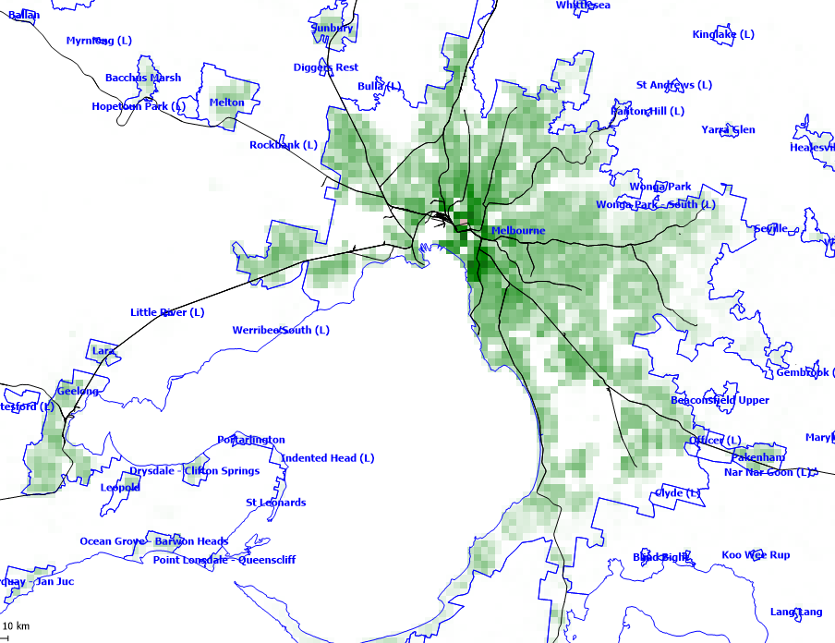
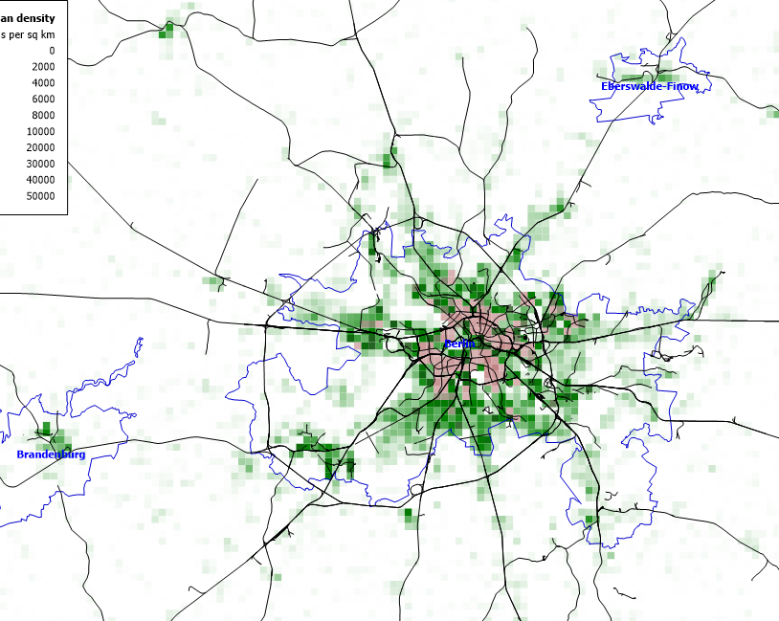
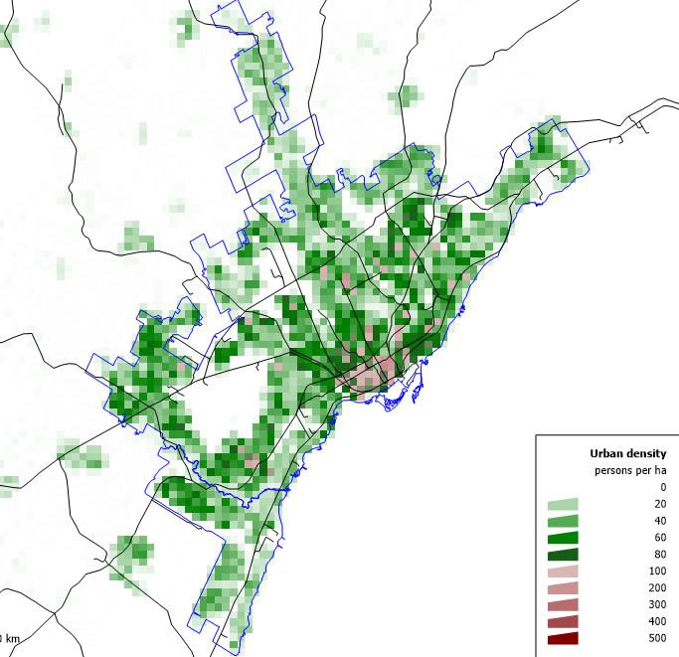
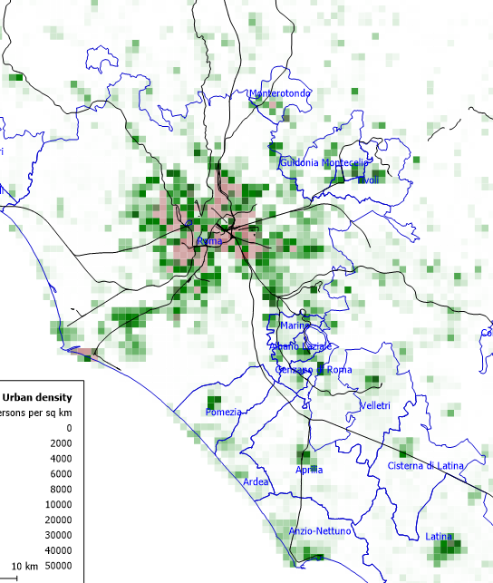
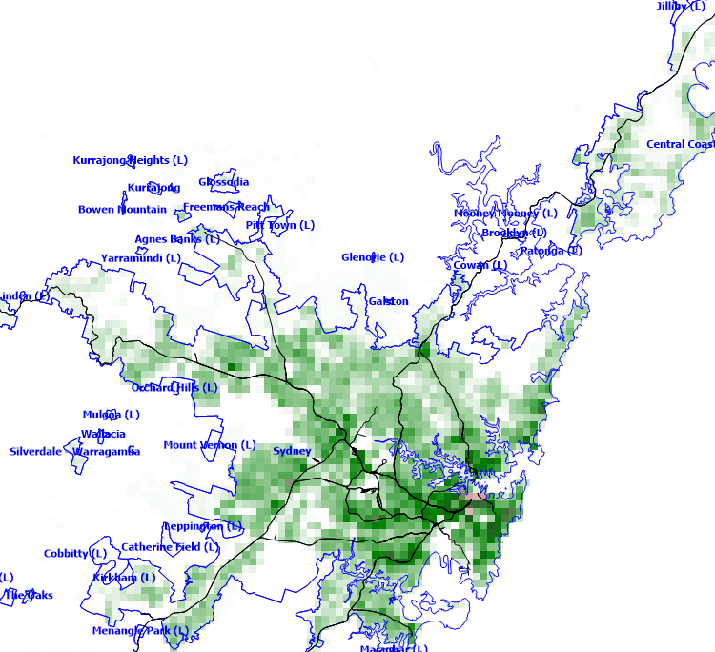
Melbourne (3.6m)
Berlin (3.7m)
Persons/hectare
0
20
40
60
80
100
200
300
400
500
Toronto (6.0m)
Rome (2.7m)
Sydney (3.8m)
Notes:
Title:
Units:
Notes:
Source: Charting transport

Slide 76
All dwellings
2015-16 – capitals only
Houses
Apartments, units, townhouses etc.
Dwelling price decile
Notes:
Title: Cheaper dwellings have increased in price by more than expensive dwellings over the past decade
Units: Per cent change in dwelling prices between 2003-04 and 2015-16, by dwelling price decile in each year
Notes: average dwelling price in each decile. ‘Semi-detached/townhouses’ includes semi-detached house, row or terrace house and townhouse.
Source: ABS Survey of Income and Housing
C:\Users\wiltshire\Dropbox (Grattan Institute)\Budget Repair Report\Data and analysis\Housing and mortgage affordability\2017 Housing affordability op ed\Rents and house price distribution analysis - SIH.xlsx

Slide 77
All dwellings
2015-16 – capitals only
Houses
Apartments, units, townhouses etc.
Private rental decile
Notes:
Title: Rents for cheaper dwellings have increased the most over the past decade
Units: Per cent change in rents between 2003-04 and 2015-16, by rent decile in each year
Notes: average rent in each decile. ‘Semi-detached/townhouses’ includes semi-detached house, row or terrace house and townhouse.
Source: ABS Survey of Income and Housing
C:\Users\wiltshire\Dropbox (Grattan Institute)\Budget Repair Report\Data and analysis\Housing and mortgage affordability\2017 Housing affordability op ed\Rents and house price distribution analysis - SIH.xlsx

Slide 78
2015-16 – rentals from parents and relatives removed
All dwellings
Houses
Apartments, units, townhouses etc.
Private rental decile
Notes:
Title: Rents for cheaper dwellings have increased the most over the past decade
Units: Per cent change in rents between 2003-04 and 2015-16, by rent decile in each year
Notes: average rent in each decile. ‘Semi-detached/townhouses’ includes semi-detached house, row or terrace house and townhouse.
Source: ABS Survey of Income and Housing
C:\Users\wiltshire\Dropbox (Grattan Institute)\Budget Repair Report\Data and analysis\Housing and mortgage affordability\2017 Housing affordability op ed\Rents and house price distribution analysis - SIH.xlsx

Slide 79
All dwellings
Houses
Apartments,units, townhouses etc.
Dwelling price decile
Notes:
Title: Cheaper dwellings have increased in price by more than expensive dwellings over the past decade
Units: Per cent change in dwelling prices between 2003-04 and 2013-14, by dwelling price decile in each year
Notes: average dwelling price in each decile. ‘Semi-detached/townhouses’ includes semi-detached house, row or terrace house and townhouse.
Source: ABS Survey of Income and Housing
C:\Users\wiltshire\Dropbox (Grattan Institute)\Budget Repair Report\Data and analysis\Housing and mortgage affordability\2017 Housing affordability op ed\Rents and house price distribution analysis - SIH.xlsx

Slide 80
All dwellings
2013-14
Houses
Apartments, units townhouses etc.
Private rental decile
Notes:
Title: Rents for cheaper dwellings have increased the most over the past decade
Units: Per cent change in rents between 2003-04 and 2013-14, by rent decile in each year
Notes: average rent in each decile. ‘Semi-detached/townhouses’ includes semi-detached house, row or terrace house and townhouse.
Source: ABS Survey of Income and Housing
C:\Users\wiltshire\Dropbox (Grattan Institute)\Budget Repair Report\Data and analysis\Housing and mortgage affordability\2017 Housing affordability op ed\Rents and house price distribution analysis - SIH.xlsx

Slide 81
Sydney
Melbourne
Brisbane
No. of
storeys
2-3
4-9
10-19
20-39
40+
City region
Notes:
Many mid-rise apartments are being built in the middle ring suburbs of Sydney
Apartment completions, 2014-17 completions/projected completions
Notes: The Central city region = CBD and approximately 0-2km from the CBD. City fringe region =approximately 2-5km from the CBD. Inner region =approximately 5-10km from each CBD. Middle region = approximately 10-35km from each CBD. Outer region = approximately 35km+ from the CBD. ‘Middle’ Brisbane is work in progress, ‘outer’ Brisbane is not tracked.
Source: Charter Keck Cramer
Location:

Slide 82
Annual resident population growth, 000s
Net overseas migration
Natural increase
Notes:
Title: Migration growth was much higher 2006-2016, and so capital city populations jumped
Units: Annual resident population growth, per cent
LH panel: Source: ABS 3101.0 - Australian Demographic Statistics, Jun 2016 ; Department of Immigration and Border Protection forecasts https://www.border.gov.au/ReportsandPublications/Documents/statistics/nom-september-2016.pdf
C:\Users\wiltshire\Dropbox (Grattan Institute)\Budget Repair Report\Data and analysis\Housing and mortgage affordability\2017 Housing affordability op ed\Housing op ed analysis.xlsx
RH panel: ABS 3218.0 Regional Population Growth, Australia
C:\Users\wiltshire\Dropbox (Grattan Institute)\Budget Repair Report\Data and analysis\Housing and mortgage affordability\2017 Housing affordability op ed\Population by signficnat urban area.xls
Notes: Notes: series break in 2006 when ‘net overseas migration’ definition was changed

Slide 83
Sydney
Melbourne
Brisbane
2015-2018 completions/projected completions
No. of
storeys
2-3
4-9
10-19
20-39
40+
City region
Notes:
Many mid-rise apartments are being built in the middle ring suburbs of Sydney
Apartment completions and expected completions, 2015-2018, thousands, by region and number of storeys
Notes: The Central city region = CBD and approximately 0-2km from the CBD. City fringe region =approximately 2-5km from the CBD. Inner region =approximately 5-10km from each CBD. Middle region = approximately 10-35km from each CBD. Outer region = approximately 35km+ from the CBD. ‘Middle’ Brisbane is work in progress, ‘outer’ Brisbane is not tracked.
Source: Charter Keck Cramer
Location:

Slide 84
Sydney
Melbourne
Brisbane
2015-16 completions
No. of
storeys
2-3
4-9
10-19
20-39
40+
City region
Notes:
Many mid-rise apartments are being built in the middle ring suburbs of Sydney
Apartment completions, 2015-2016, thousands, by region and number of storeys
Notes: The Central city region = CBD and approximately 0-2km from the CBD. City fringe region =approximately 2-5km from the CBD. Inner region =approximately 5-10km from each CBD. Middle region = approximately 10-35km from each CBD. Outer region = approximately 35km+ from the CBD. ‘Middle’ Brisbane is work in progress, ‘outer’ Brisbane is not tracked.
Source: Charter Keck Cramer
Location:

Slide 85
Sydney
Melbourne
Brisbane
No. of
storeys
2017-18 completions/projected completions
2-3
4-9
10-19
20-39
40+
City region
Notes:
Many mid-rise apartments are being built in the middle ring suburbs of Sydney
Apartment completions, 2015-2016, thousands, by region and number of storeys
Notes: The Central city region = CBD and approximately 0-2km from the CBD. City fringe region =approximately 2-5km from the CBD. Inner region =approximately 5-10km from each CBD. Middle region = approximately 10-35km from each CBD. Outer region = approximately 35km+ from the CBD. ‘Middle’ Brisbane is work in progress, ‘outer’ Brisbane is not tracked.
Source: Charter Keck Cramer
Location:

Slide 86
Age group
25-34
35-44
45-54
55-64
1981
2016
Equivalised household income quintile
Notes:
Title: Home ownership is falling for younger age groups, and particularly among low income earners
Units: Home ownership rates by age and income, 1981 and 2016
Notes: This graph updates Burke et al 2014 using Census data obtained from the ABS. Difficulties in accurately calculating household incomes across time using Census data means that changes in home ownership rates by age and income are indicative and small changes in ownership rates should be ignored. Excludes households with tenancy not stated (for 2016) and incomes not stated. Household age group according to age of household reference person. Income quintiles are equivalised household income quintiles.
Source: ABS Census; Burke et al 2014 ‘Generational change in home purchase opportunity in Australia’; Grattan Institute
NB: change arrow size to roughly the required size and then copy and paste in each point
C:\Users\wiltshire\Dropbox (Grattan Institute)\Budget Repair Report\Data and analysis\Housing and mortgage affordability\Census 2011 and 2016\Home ownership - by age and income - Census 2016.xlsx

Slide 87
Financial year ending
Notes:
Proportion of all households in state-territory housing authority
Source: ABS Housing Occupancy and Costs, 2015-16

Slide 88
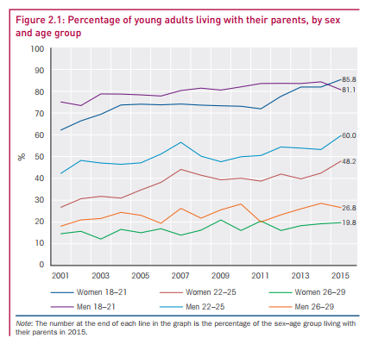
65+
55-64
45-54
35-44
25-34
Survey year – financial year ending
Notes:
More young people are living with their parents
Percentage of young adults living with their parents, by sex and age group
Source: http://melbourneinstitute.unimelb.edu.au/__data/assets/pdf_file/0010/2437426/HILDA-SR-med-res.pdf

Slide 89
2005-06
$600,000 wealth increase
2015-16
Age of head of household
Notes:
The wealth of older households has increased in ways that are unlikely to be repeated
Wealth per household, $2015-16, thousands
Source: ABS Household Expenditure Survey and ABS Survey of Income and Housing, various years.

Slide 90
2016
2001
Notes:
TITLE: House price to income ratios have jumped in cities AND regions
Units: Ratio of median dwelling price to median annual gross household income
Notes: median household income from ANU analysis
Source: Core Logic Housing Affordability Report – December 2016

Slide 91
Percentage of median household gross income
If interest rates increase by 2% in
2019-20
Percentage of mean household disposable income
Notes:
Title: Income required to service a mortgage is below pre-GFC peak, but will increase if interest rates rise
Units: Per cent of household income to service an 80 per cent loan-to-valuation ratio mortgage on average residential dwelling at then current interest rates
Notes: Mean income is household disposable income from National Accounts measure of income (based on ABS), which includes superannuation income and imputed rent. Median household income is gross household income from ABS 6523.0 - Household Income and Wealth, Australia, 2013-14. Future scenario assumes house prices and incomes grow at 3 per cent per annum.
Source: Grattan analysis of ABS
Location: <C:\Users\wiltshire\Dropbox (Grattan Institute)\Budget Repair Report\Data and analysis\Housing and mortgage affordability\2017 Housing affordability op ed\Housing and mortgage costs-affordability simulations.xlsx> tab “Mortgage serviceability”

Slide 92
If interest rates increase by 2% in
2019-20
Notes:
Title: Income required to service a mortgage is below pre-GFC peak, but will increase if interest rates rise
Units: Per cent of household income to service an 80 per cent loan-to-valuation ratio mortgage on average residential dwelling at then current interest rates
Notes: Mean income is household disposable income from National Accounts measure of income (based on ABS), which includes superannuation income and imputed rent. Median household income is gross household income from ABS 6523.0 - Household Income and Wealth, Australia, 2013-14. Future scenario assumes house prices and incomes grow at 3 per cent per annum.
Source: Grattan analysis of ABS
Location: <C:\Users\wiltshire\Dropbox (Grattan Institute)\Budget Repair Report\Data and analysis\Housing and mortgage affordability\2017 Housing affordability op ed\Housing and mortgage costs-affordability simulations.xlsx> tab “Mortgage serviceability”

Slide 93
2007-08
2009-10
2011-12
2013-14
2015-16
All low income
Greater capital city areas
Non-capital city areas
Low-income renters
Notes:
Title: Rental stress among low-income households is increasing in capital cities
Units: Per cent of low-income renters with housing costs more than 30 per cent of gross household income
Notes: Low income households are defined as the 40 per cent of households with equivalised disposable household income (excluding Commonwealth Rent Assistance) at or below the 40th percentile.
Source: ABS 4130.0 - Housing Occupancy and Costs
C:\Users\wiltshire\Dropbox (Grattan Institute)\Budget Repair Report\Data and analysis\Housing and mortgage affordability\4130 - Housing occupancy and costs\Housing occupancy and costs - analysis.xlsx

Slide 94
2007-08
2009-10
2011-12
2013-14
2015-16
Low-income renters
‘Average’ renters
Notes:
Title: Rental stress among low-income households is increasing in capital cities
Units: Per cent of low-income renters with housing costs more than 30 per cent of gross household income
Notes: Low income households are defined as the 40 per cent of households with equivalised disposable household income (excluding Commonwealth Rent Assistance) at or below the 40th percentile.
Source: ABS 4130.0 - Housing Occupancy and Costs
C:\Users\wiltshire\Dropbox (Grattan Institute)\Budget Repair Report\Data and analysis\Housing and mortgage affordability\4130 - Housing occupancy and costs\Housing occupancy and costs - analysis.xlsx

Slide 95
Dwellings completed per year, thousands
Population increase per year, thousands
Dwelling construction (LHS)
Split into two side by side, area charts
Then add extra chart of 4 panel, state completions per population, extended back to 1980
Population
increase (RHS)
Qld
Other
Vic
SA
NSW
WA
Notes:
Title: Housing construction lagged population growth for much of the 2000s, but picked up recently
Units: On chart
Source: ABS 8752.0 Building Activity, Australia; ABS 3101.0 Australian Demographic Statistics; Grattan analysis
Location: C:\Users\wiltshire\Dropbox (Grattan Institute)\Budget Repair Report\Data and analysis\Housing and mortgage affordability\87310020 - Dwelling approvals - Australia - types of dwellings.xlsx
ABS source: http://www.abs.gov.au/AUSSTATS/abs@.nsf/DetailsPage/8731.0Jan%202017?OpenDocument

Slide 96
Notes:
Proportion of all households in state-territory housing authority, by state/territory
Source: ABS Housing Occupancy and Costs, 2013-14

Slide 97
Notes:
Proportion of all households in state-territory housing authority, by state/territory
Source: ABS Housing Occupancy and Costs, 2013-14

Slide 98
Number of property interests per taxpayer
Notes:
Title: Only 10% of landlords own more than two residential investment properties
Sub-title: Share of total investment properties by number of properties owned by investor, 2014-15
Note: An interest in a property means the property is either solely owned, or jointly owned for all or part of the year.
Source: Grattan analysis of ATO Taxation Statistics, 2014-15

Slide 99
Size
% of national economy (2014-15)
% of population growth (2004-14)
% of road & rail investment (2006-15)
State
Commonwealth
Notes:
Government transport spending has not reflected distribution of growth in the economy or population
Size and transport infrastructure spending, per cent of Australian total
Notes: The percentage of the national economy is based on the 2014-15 financial year. Population growth is over the 10 years from June 2004 to June 2014. Road and rail investment is over the 10 years from 2005-06 to 2014-15.Road and rail investment does not include the private sector contribution to public-private partnerships. If this were included, the proportion of spending in urban areas would be slightly higher.
Source: Grattan analysis of Commonwealth and State budget papers 2005-06 to 2014-15,
ABS 3218.0 Regional Population Growth (pop growth),
SGS Economics & Planning Australian Cities Accounts 2014-15 (% of economy),
Department of Infrastructure and Regional Development (unpublished) – Jessica Hall data
Internal notes:
A big shortcoming of these numbers is the significant proportion of rail investment that’s not identifiable as being urban or regional.
Analysis in S:\Staff_personal_files\Owain\Where did the money go\Regional comparisons.xlsx

Slide 100
1995/96
1997/98
2000/01
2002/03
2005/06
2007/08
2009/10
2011/12
2013/14
2015/16
Notes:
Title: Fewer Australians own their homes outright than in the past
Units: Per cent of households that own home outright, by age group
Notes: by age of household reference person
Source: 4130.0 - Housing Occupancy and Costs, 2013-14 + income and wealth
C:\Users\wiltshire\Dropbox (Grattan Institute)\Budget Repair Report\Data and analysis\Housing and mortgage affordability\4130 - Housing occupancy and costs\41300do001_201314 - Table 1.xls – TABLE 3

Slide 101
Would not like it
Don’t care
Would like it
Other / don’t know
Notes:
Community attitudes to increased population in their neighbourhoods
From getting the housing we want
From Pc report - https://www.pc.gov.au/inquiries/completed/regulation-benchmarking-planning/report/planning-volume1.pdf , table 2.4

Slide 102
NSW
Land tax
Post-tax income return
Victoria
Queensland
Small investor
(1 property)
Medium investor
(5 properties)
Large investor
(25 properties)
Size of investor
Notes:
Progressive land taxes discourage large investors from holding residential property
Land tax paid and post-tax income return, % of asset value
Notes: Based on $880,000 median-priced Sydney dwelling and a 4 per cent gross rental return. The land value is assumed to be half the value of the property. Applies 2017 NSW land tax regime. Ignores deductibility of land tax costs against income in personal and corporate income tax returns.
Source: NSW Office of State Revenue; Corelogic; Grattan analysis.

Slide 103
Land tax consumes almost ¼ of income return for large investor
Land tax
For the same property, a large investor takes home only 77% of the rent received by a small investor
Post-tax income return
Small investor
(1 property)
Medium investor
(5 properties)
Large investor
(25 properties)
Size of investor
Notes:
Progressive land taxes discourage large investors from holding residential property
Land tax paid and post-tax income return, % of asset value
Notes: Based on $880,000 median-priced Sydney dwelling and a 4 per cent gross rental return. The land value is assumed to be half the value of the property. Applies 2017 NSW land tax regime. Ignores deductibility of land tax costs against income in personal and corporate income tax returns.
Source: NSW Office of State Revenue; Corelogic; Grattan analysis.

Slide 104
First home buyer packages
First home buyer grant doubled
First home buyer policy changes
NSW and Vic stamp duty concessions
NSW, Vic, Qld, NT
WA
SA, Tas, ACT
Notes:
Number of dwellings financed, FHBs, monthly (includes refinancing)
Original , three-month moving average
C:\Users\wiltshire\Dropbox (Grattan Institute)\Budget Repair Report\Data and analysis\Housing and mortgage affordability\First home buyer finance commitments\56090 Housing Finance, Australia, August 2017, Table 9b.xlsx
Location: C:\Users\wiltshire\Dropbox (Grattan Institute)\Budget Repair Report\Data and analysis\Housing and mortgage affordability\First home buyer finance commitments\56090 Housing Finance, Australia, August 2017, Table 9b.xlsx
Source: 5609.0 - Housing Finance, Australia, August 2017; ANZ
Deakin paper - https://ojs.deakin.edu.au/index.php/dpibe/article/download/52/59 - “March and December 2001, an additional grant of $7,000 was introduced for new home sales. The additional grant was reduced to $3,000 from December 2001 to June 2002 and then the total grant reduced to the original $7,000.”
Eslake Prosper speech - https://www.prosper.org.au/2013/09/03/saul-eslake-50-years-of-housing-failure/

Slide 105
Total scheduled repayments
Interest
Scheduled principal
If interest rates increase by 2ppt by
2019-20
Notes:
Chart title: The costs of servicing a mortgage are far higher now than in the early 1990s
Y-axis label: Mortgage interest payments as a share of disposable income, per cent
Note(s):
Source(s): RBA Statistical Tables, E2: Household finances – selected ratios.
File Path: ='C:\Users\wiltshire\Dropbox (Grattan Institute)\Budget Repair Report\Data and analysis\Housing and mortgage affordability\[RBA Household Finances – Selected Ratios – E2-data.csv]RBA Household Finances – Select'!K18
Data thief from Chart 2.5 of RBA October 2018 FSR - https://www.rba.gov.au/publications/fsr/2017/oct/pdf/financial-stability-review-2017-10.pdf

Slide 107
2005-06
2013-14
House price decile (AHURI)
2005-06
2016-17
Weighted house price decile (Grattan Institute)
Notes:
Most new houses are in LGAs with price around the median
Share of new housing approvals (per cent) in each LGA, ranked by house price deciles
Notes: Weighted price deciles are calculated by ranking LGAs from lowest to highest according to their median price values, and dividing into deciles weighted by the total dwelling stock in each LGA so that each decile has a similar number of dwellings. For example, in 2016-17, for the ‘Weighted house price decile’ panel each decile has on average 985,000 dwellings (LGAs without price data were excluded). All building approvals for an LGA are assigned to the decile that it sits in. An LGA may not be in the same decile in both 2005–06 and 2016–17. LGAs are as they were in 2006 and 2016, with best available price data assigned to that LGA. Some small LGAs excluded. ‘Units, apartment, townhouses’ includes approvals for units, apartments, flats, semi-detached, row or terrace houses or townhouses.
Source: Ong et al 2017; Grattan analysis based on CoreLogic data; ABS Census; ABS 8731.0 Building Approvals.

Slide 108
2001-06
2006-11
Sydney
Melbourne
Sydney
Melbourne
Sydney
Melbourne
Sydney
Melbourne
Inner
Middle
Outer
Notes:
Title: Most jobs growth was in city centres over the last decade
Units: Employment growth, Sydney and Melbourne, thousands
Source: : Grattan analysis; BITRE

Slide 109
Dwelling completions in 2015
Housing construction in Australia has been strong, but so has population growth
Per additional person (2014 to 2015)
Per cent of the existing housing stock
Notes: Estonia, Japan and Poland not shown due to large negative numbers. Dwelling construction data for 2015 or closest year.
Source: OECD Affordable Housing Database; United Nations population database

Slide 110
Dwelling completions in 2015
Housing construction in Australia has been strong, but so has population growth
Per additional person (2014 to 2015)
Notes: Estonia, Japan and Poland not shown due to large negative numbers. Dwelling construction data for 2015 or closest year.
Source: OECD Affordable Housing Database; United Nations population database

Slide 111
Notes:
Housing construction in Australia has been strong, but so has population growth
Dwelling completions per additional thousand people (2014 to 2015)
Notes: Estonia, Japan and Poland not shown due to large negative numbers. Dwelling construction data for 2015 or closest year.
Source: OECD Affordable Housing Database; United Nations population database

Slide 112
2015
2000
Notes:
Australia has a small housing stock relative to population, and it is shrinking
Dwelling stock per 1,000 people
Notes:
Source: OECD Affordable Housing Database

Slide 113
Notes:
Australia has a small housing stock relative to population, and it is shrinking
Dwelling stock per 1,000 people
Notes:
Source: OECD Affordable Housing Database

Slide 114
Portugal
Bulgaria
France
Finland
Switzerland
Austria
Germany
Cyprus
Sweden
Denmark
Netherlands
Hungary
Norway
Lithuania
Ireland
2000
UK
USA
2015
Luxembourg
Australia
New Zealand
Poland
Chile
250
300
350
400
450
500
550
600
Notes:
For its population, Australia has relatively little housing stock, and it’s falling
Dwelling stock per 1,000 people
Notes:
Source: OECD Affordable Housing Database

